Slide 1
Employee Advocacy Competition
[Month] [Year] Results
[Your Logo]

Slide 2
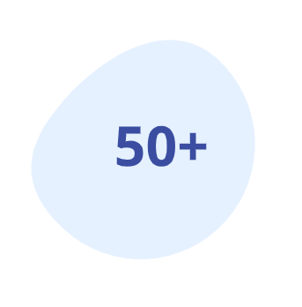
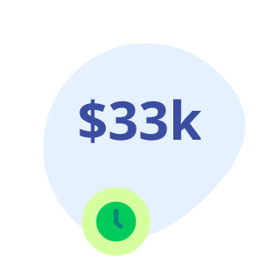
YOU HELPED US GET SEEN
1.000
Likes and Reactions
3M+
Active Participants
Reach
200+
Completed Activities
CPM Savings
[Your Logo]
Document Title

Slide 3
TITLE
Shanee Yaffe
Shanee Yaffe
Designer
Designer
Shanee Yaffe
Shanee Yaffe
Designer
Designer
Shanee Yaffe
Shanee Yaffe
Designer
Designer
Shanee Yaffe
Shanee Yaffe
Designer
Designer
Shanee Yaffe
Shanee Yaffe
Designer
Designer
[Your Logo]
Document Title

Slide 4
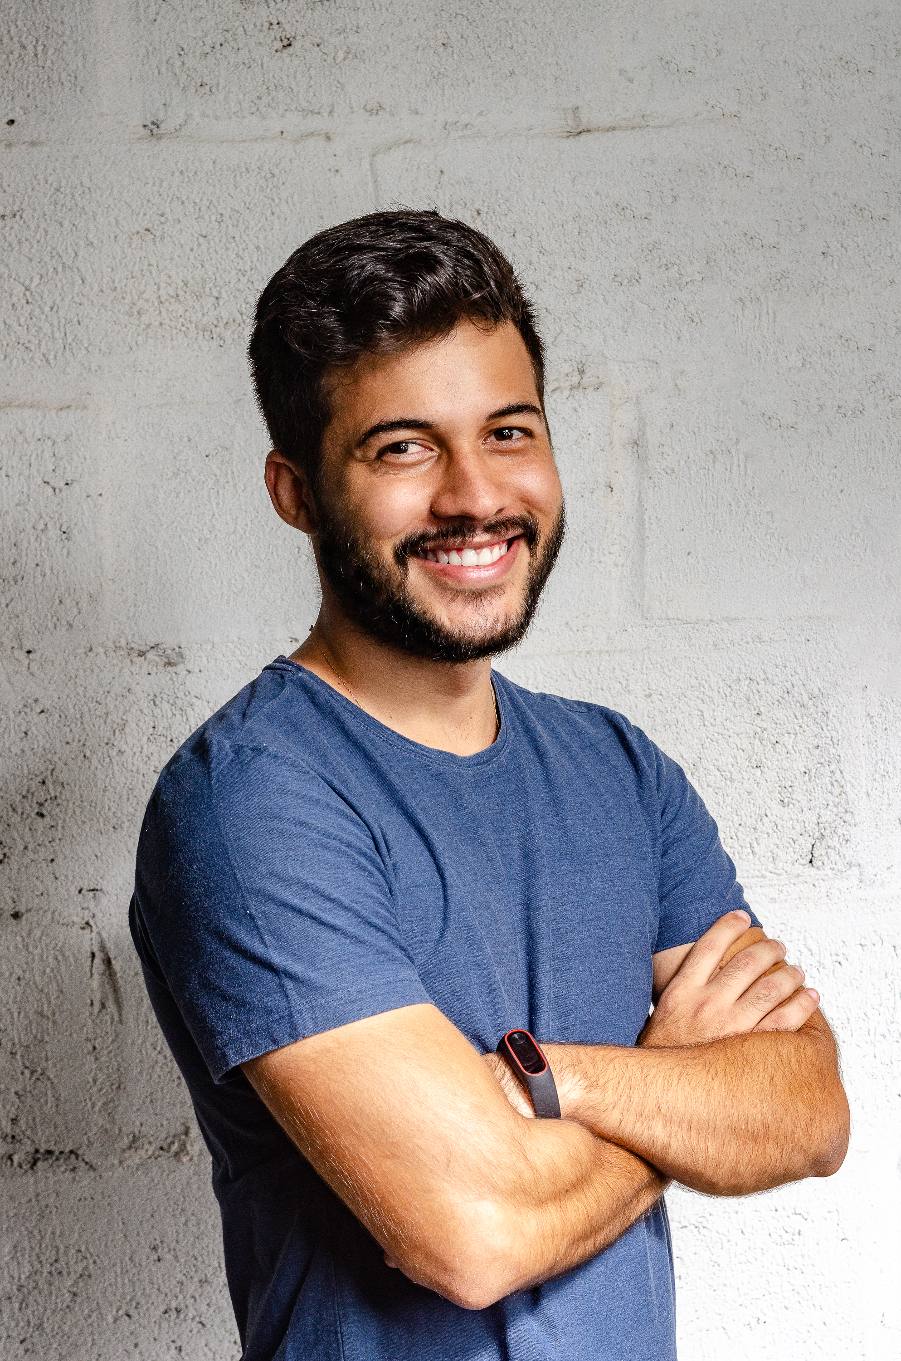
OUR HONORARY AWARDS
AWESOME
AWESOME
Shanee Yaffe
Eduardo De La Cruz
Director of Marketing, GaggleAMP
Business Analyst
[Your Logo]
Document Title

Slide 5
LET’S SPIN THE WHEEL!
The winner can choose between prize 1 or prize 2
Only first-place participants can win the grand prize
All first-place participants will win a small prize
The winner will be selected at random with the spin wheel
[Your Logo]
Document Title

Slide 6
[Your Logo]
Thank You!

